Slide 1
ctcLink
How to pay tuition/check tuition bill

Slide 2
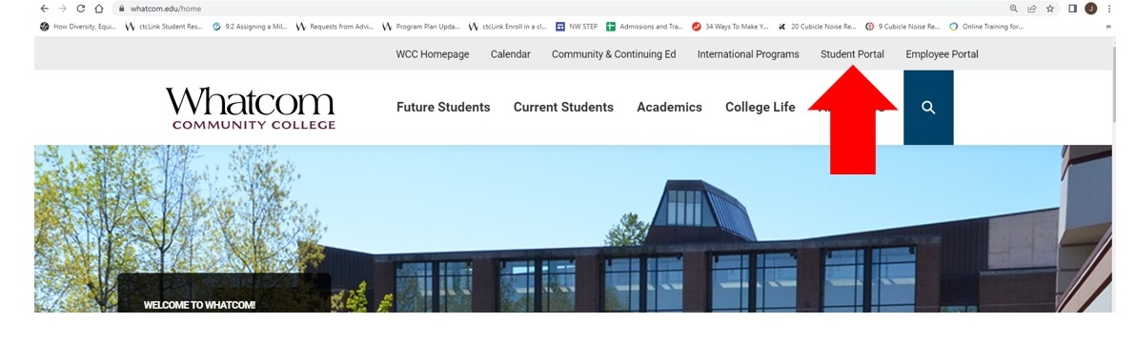
Step 1: Open a browser and go to WCC homepage (whatcom.edu). Then, click on student portal

Slide 3
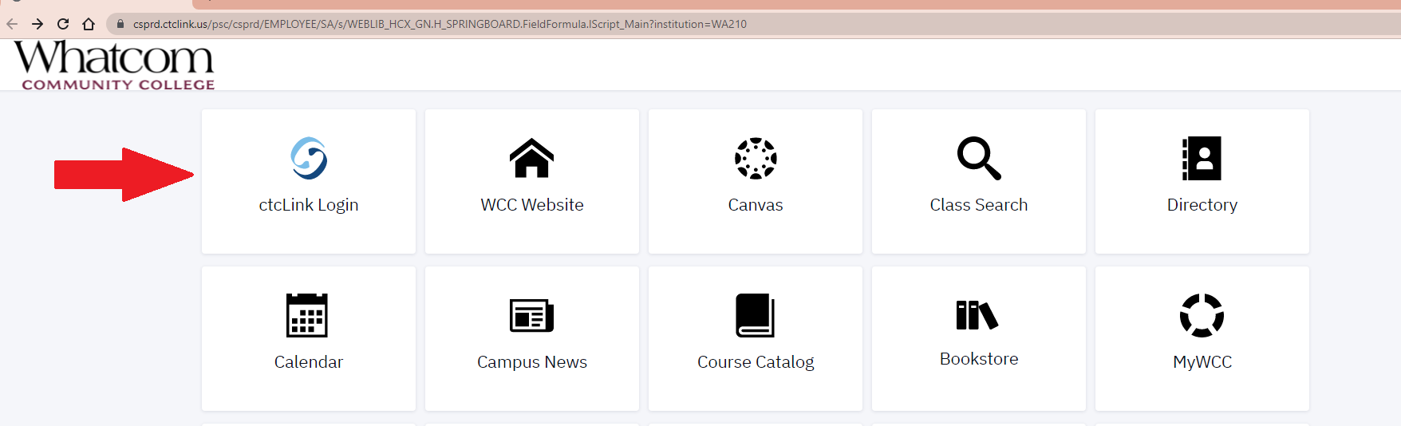
Step 2: Click on ctcLink logo and log-in.

Slide 4
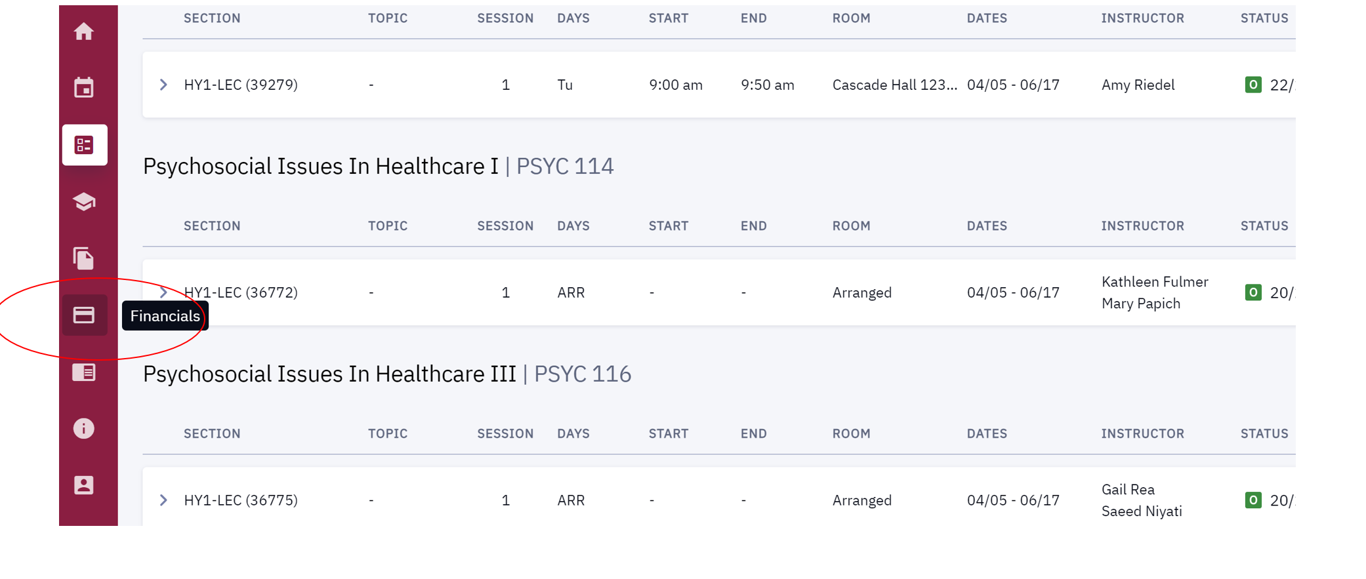
Step 3. Click on financials on the left-hand menu

Slide 5
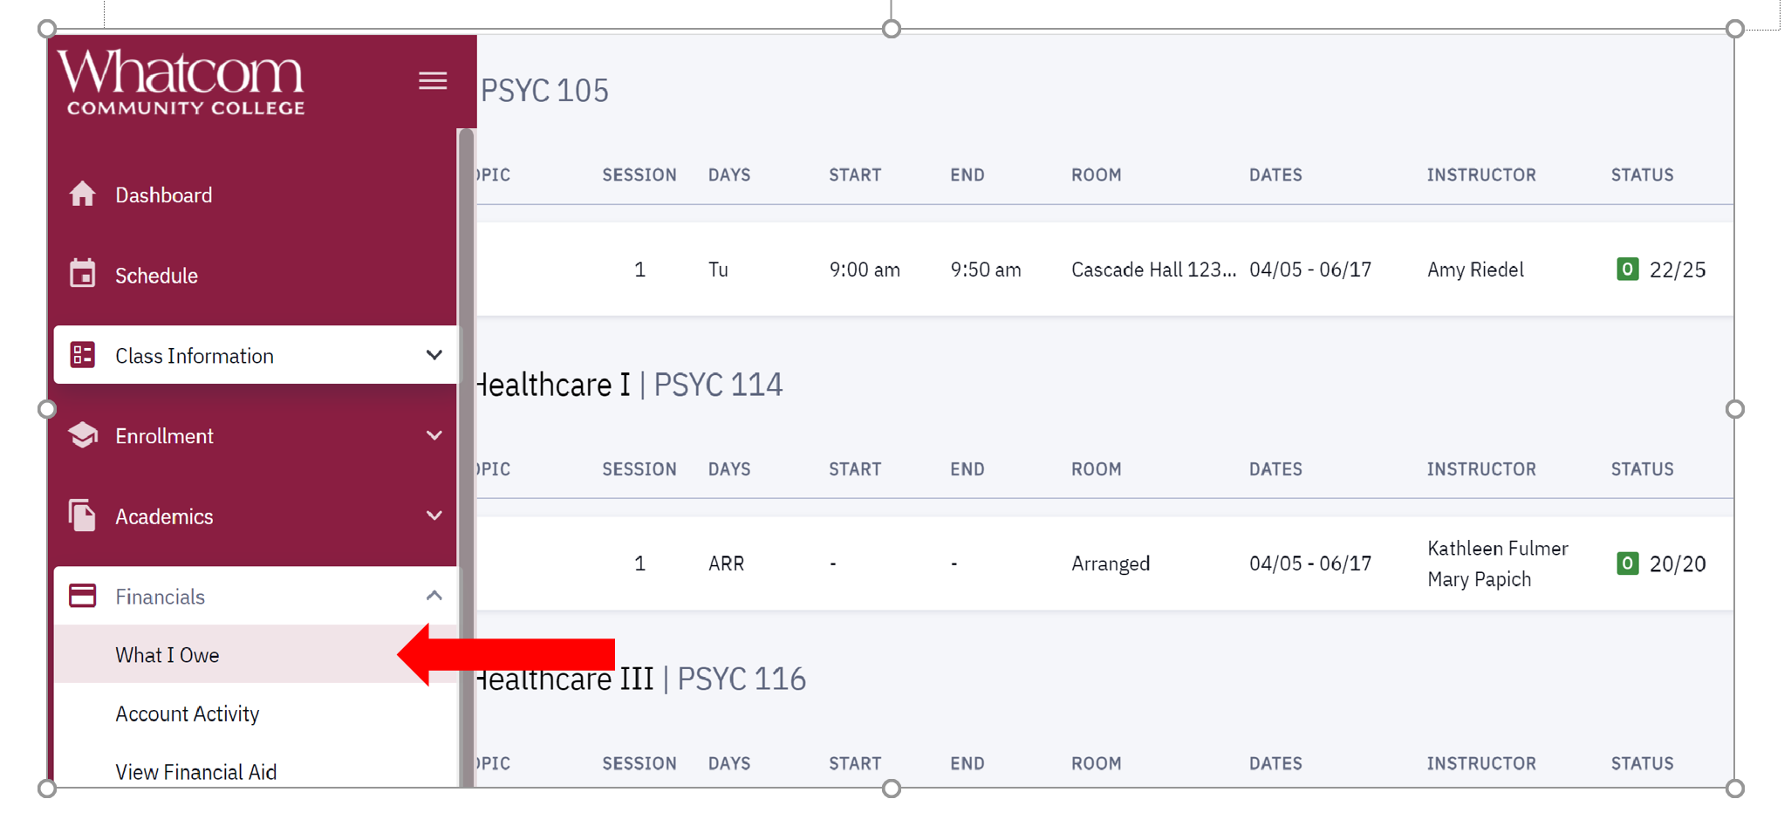
Step 4. Click on ‘what I owe’

Slide 6
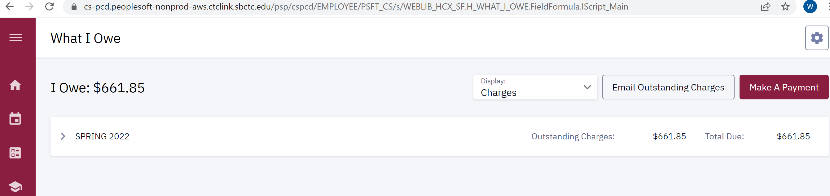
Step 5. The amount of tuition will be listed

Slide 7
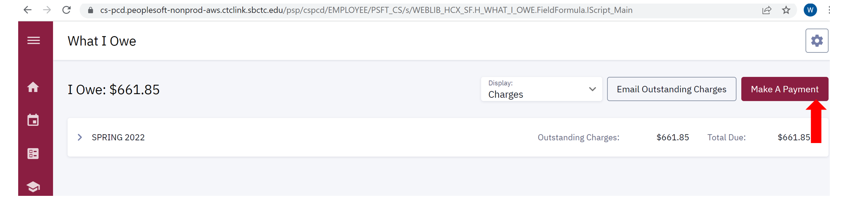
Step 6. Click on ‘make a payment’ button

