Slide 1
ctcLink How to find your enrollment date
Enrollment date is the earliest day/time you can sign-up for classes. Check the WCC calendar for more important dates like when the quarter begins.

Slide 2
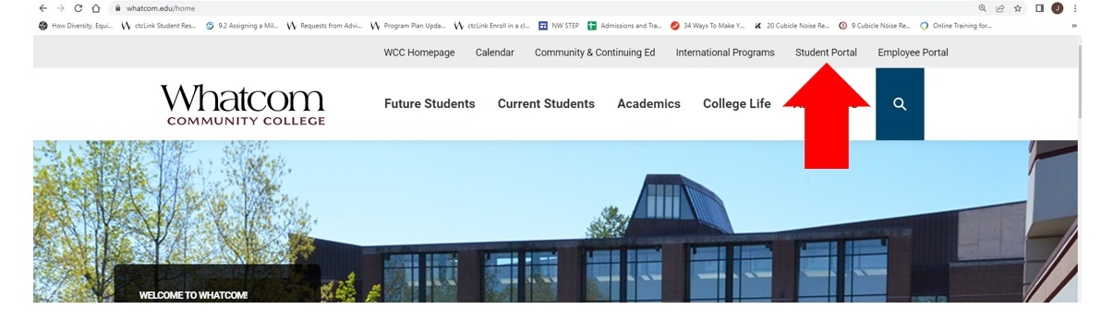
Step 1: Open a browser and go to WCC homepage (whatcom.edu). Then, click on student portal

Slide 3
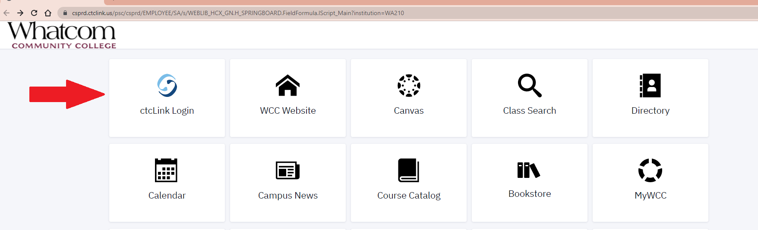
Step 2: Click on ctcLink logo and log-in.

Slide 4
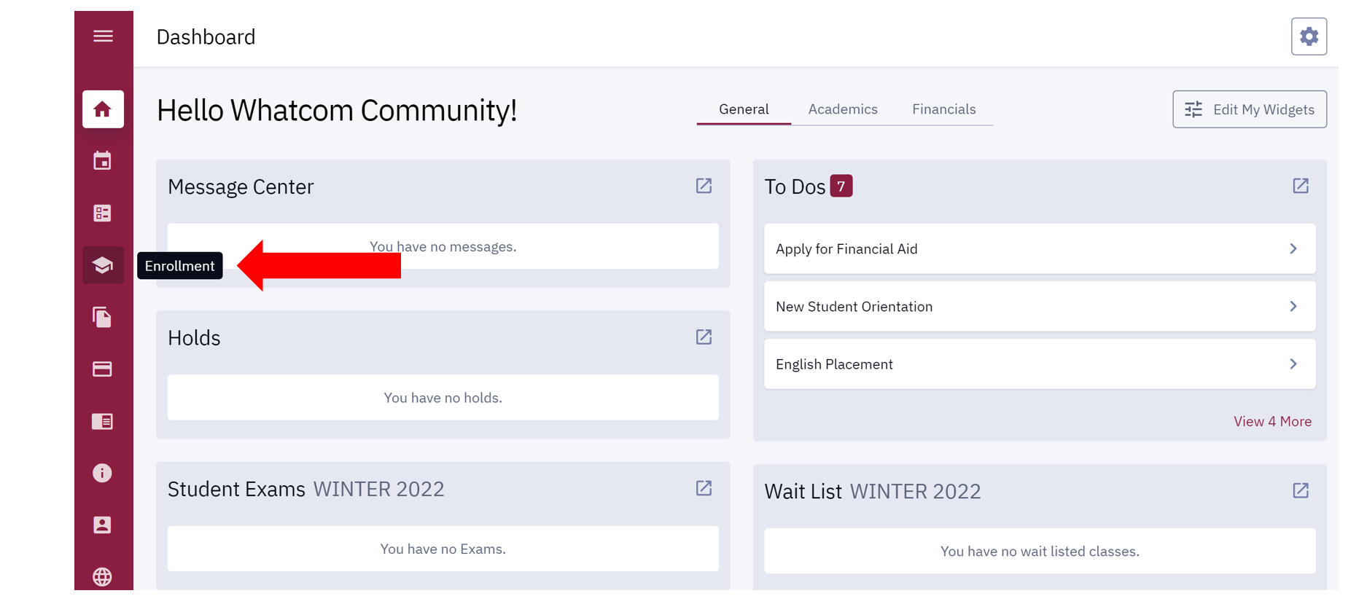
Step 3: Click on enrollment icon (graduation hat)

Slide 5
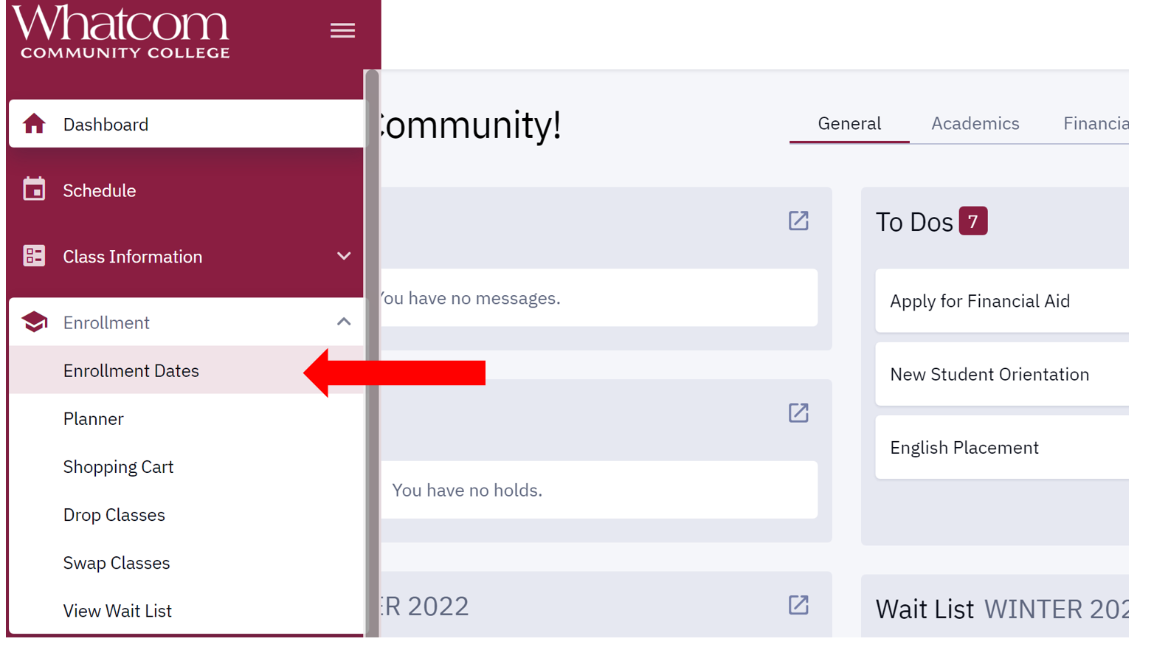
Step 4: Click on enrollment dates

Slide 6
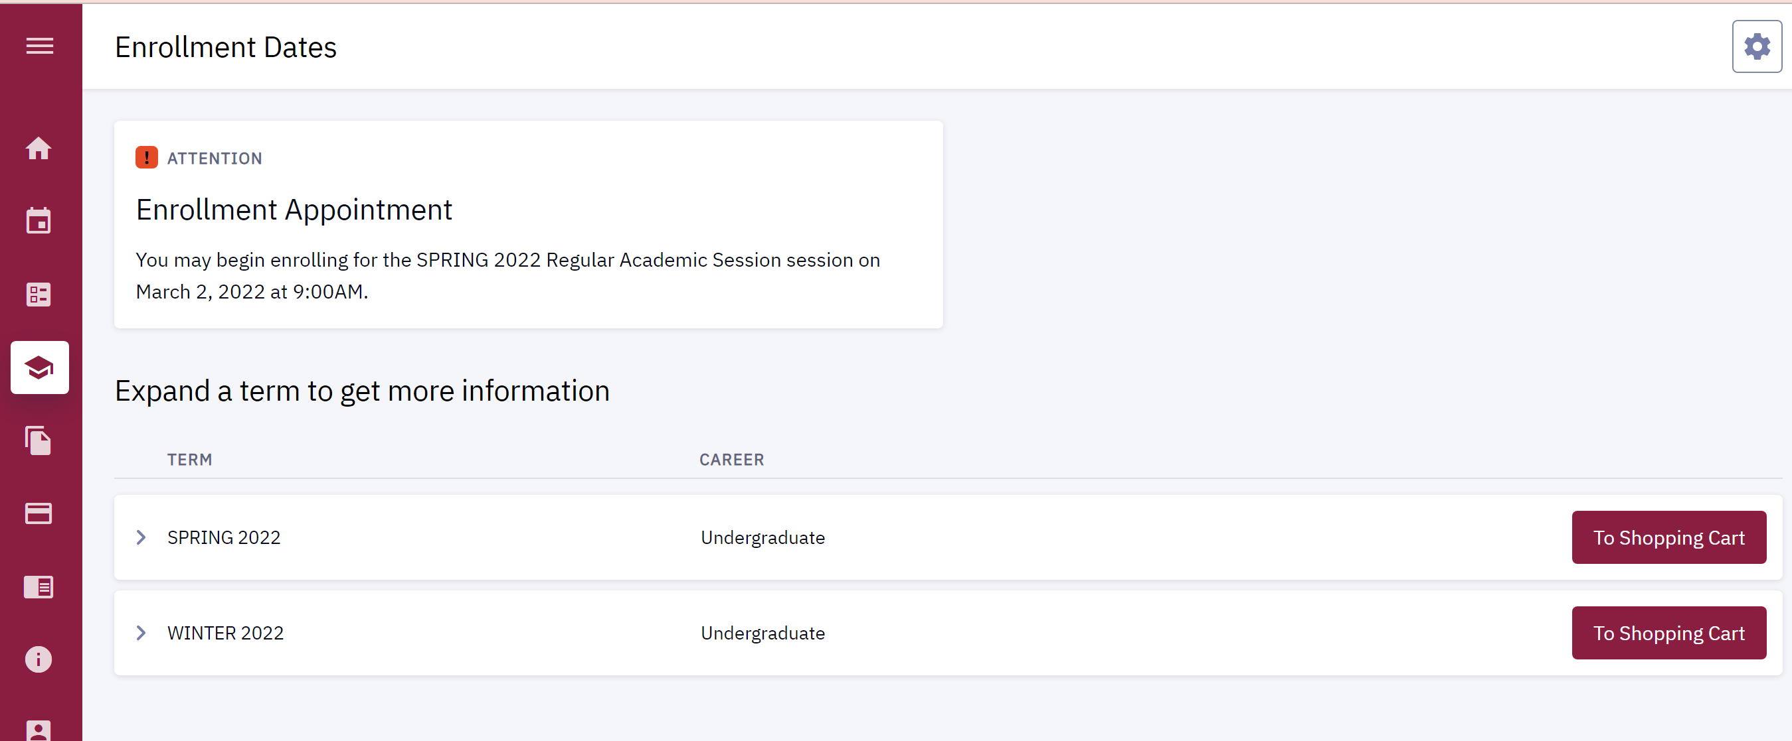
Your enrollment time will be listed at the top of the page. Click on the specific term for more information.

